Slide 1

Notes:
https://www.youtube.com/watch?v=32u5T6lO8qk
Key Objective: Set an executive, urgent tone and introduce the primary thesis.
Welcome everyone. Today’s briefing isn’t just about market trends or quarterly asset allocation; it’s a high-level systemic threat intelligence assessment based on insights from Jeremy Grantham, a 60-year market veteran who managed $165B in assets.
The main title, "The Fraying Edges of the System," highlights that we are not dealing with isolated market corrections or single-industry hiccups. We are looking at interconnected crises spanning the economy, technology, human biology, and the social contract.
Our core focus today is understanding the AI mega-bubble and learning practical asset and life defense strategies to navigate what Grantham views as the greatest systemic unwind of our era.

Slide 2
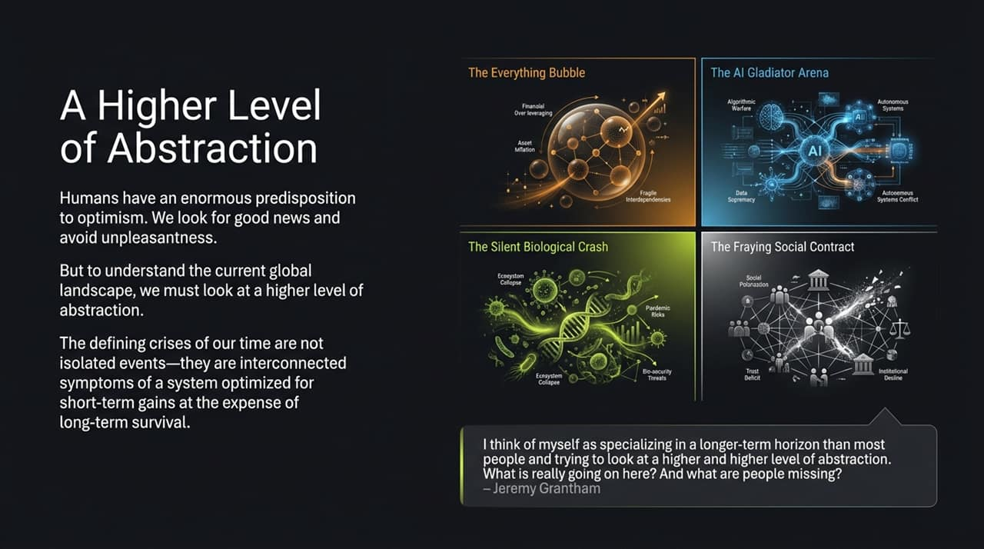
Notes:
Key Objective: Shift the audience's mindset from short-term optimism to broad-system analysis.
As human beings, we possess a strong psychological bias toward optimism. We prefer good news and naturally avoid unpleasant truths.
To see what is actually happening, Grantham urges us to move to a higher level of abstraction.
Look at the four quadrants on this slide:
The Everything Bubble (Financial markets).
The AI Gladiator Arena (Corporate capex and monopolies).
The Silent Biological Crash (Falling human fertility and environmental toxins).
The Fraying Social Contract (Inequality and institutional decay).
The key takeaway here: These are not separate crises. They are connected symptoms of a global system optimized strictly for short-term corporate profits at the expense of long-term human survival.

Slide 3
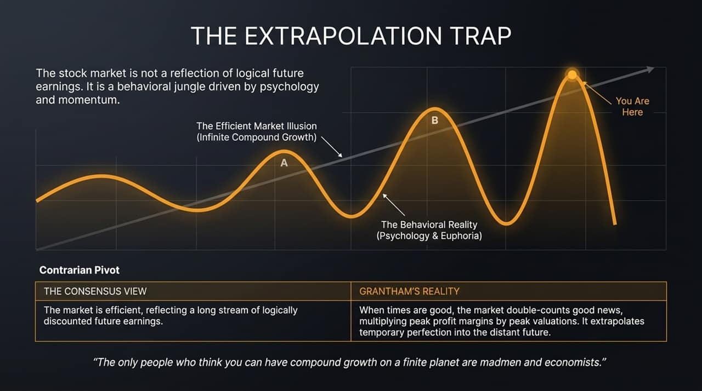
Notes:
Key Objective: Dismantle the Efficient Market Hypothesis and explain behavioral market peaks.
Wall Street teaches that the stock market is an efficient discounting mechanism for future corporate earnings. Grantham argues the exact opposite: The stock market is a behavioral jungle driven by fear, greed, and momentum.
How the Extrapolation Trap works:
When economic conditions are peak, markets double-count the good news. They multiply peak profit margins by peak valuation multiples and extrapolate temporary perfection infinitely into the future.
Notice the line on the chart: The Efficient Market Illusion assumes linear or exponential compound growth forever. But as the famous quote states: "The only people who think you can have compound growth on a finite planet are madmen and economists."
Where are we? Look at "You Are Here" at the top of the wave. We are at the peak of behavioral euphoria, right before mean reversion takes over.

Slide 4
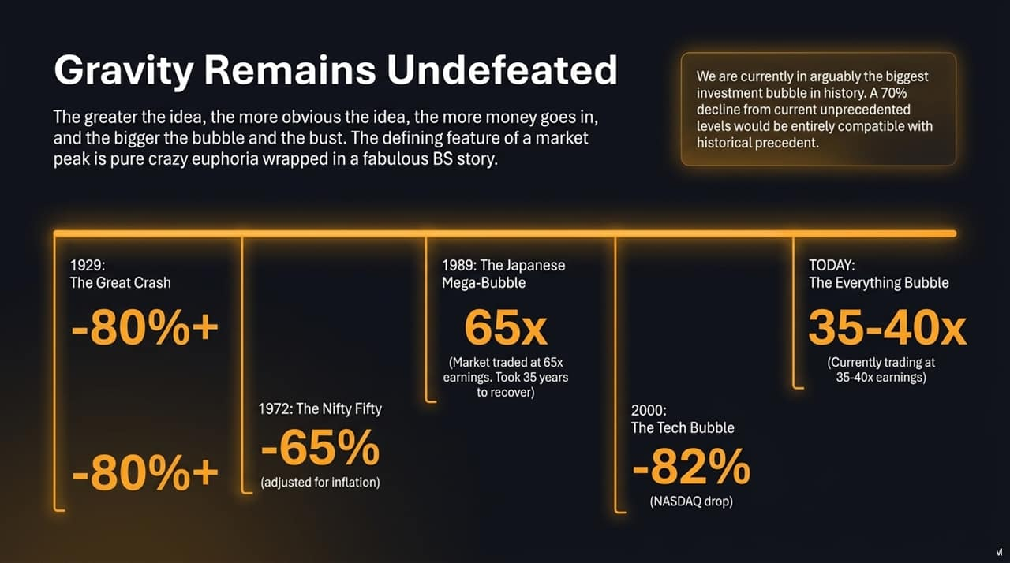
Notes:
Key Objective: Benchmark current market valuations against historical market crashes.
Market history teaches one constant law: Gravity remains undefeated. The greater and more obvious the idea, the more capital rushes in, creating a massive bubble followed by a catastrophic bust.
Market peaks are always characterized by pure euphoria wrapped in a fabulous story.
Historical Comparisons:
1929 Great Crash: Stocks dropped over 80%.
1972 Nifty Fifty: Dropped 65% (80% inflation-adjusted).
1989 Japan Mega-Bubble: Traded at 65x earnings; it took 35 years for Japanese equities to recover.

Slide 5
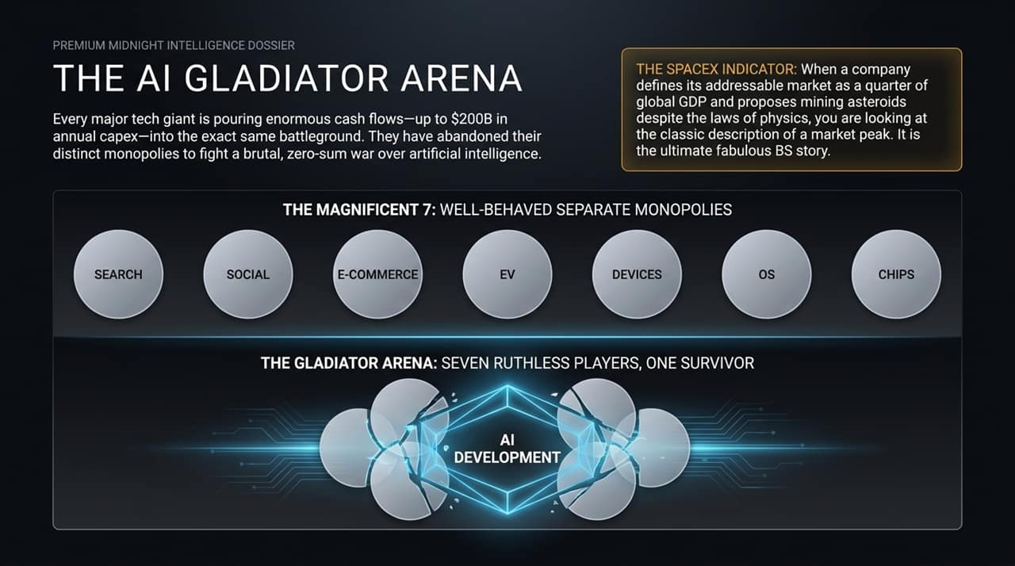
Notes:
Key Objective: Highlight the dangerous shift in Big Tech behavior and the nature of the AI bubble.
Let's look closely at the "Magnificent 7" tech giants. Historically, these companies operated as well-behaved separate monopolies: Google owned Search, Meta owned Social, Amazon owned E-Commerce, Apple owned Devices, and so on. They made vast profits in their own lanes.
The Shift: With the rise of AI, these monopolies have abandoned their distinct borders. They are now spending up to $200 Billion annually in capital expenditure to fight a zero-sum war in the exact same arena.
The SpaceX / High-Valuation Indicator: When market leaders define their total addressable market as 25% of global GDP or propose mining asteroids to justify valuations, you are looking at classic market-peak mania.
It is a winner-take-all battle where massive capital is being spent ahead of proven revenue models.

Slide 6
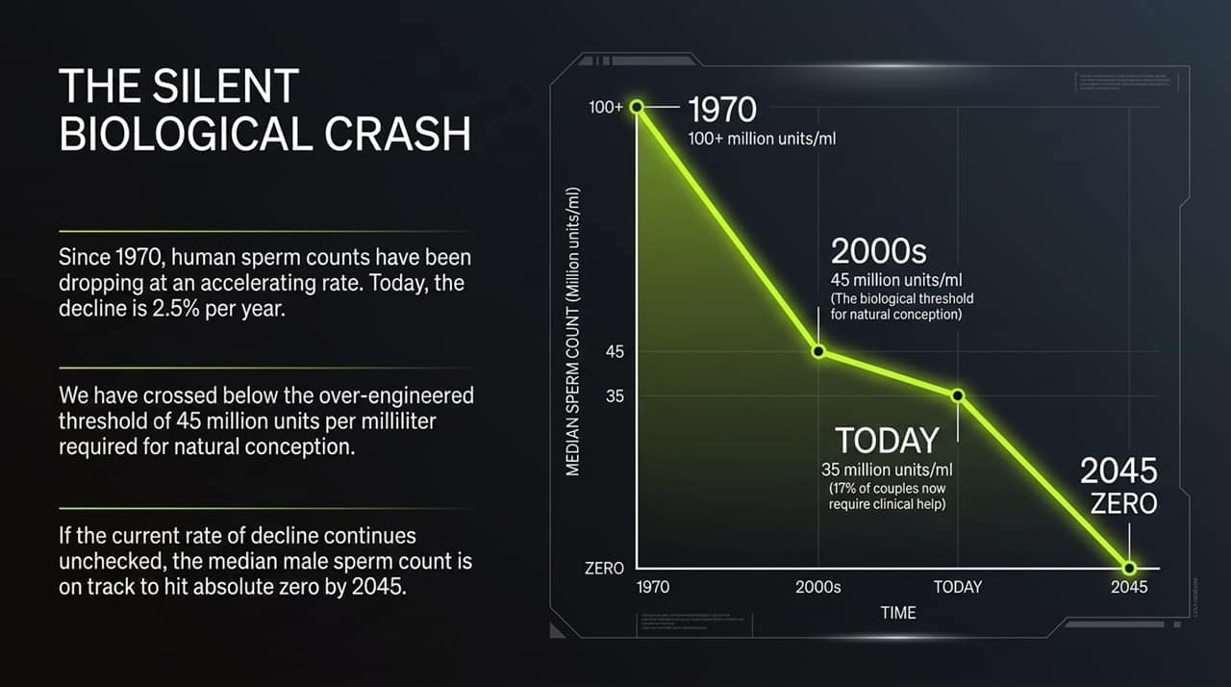
Notes:
Key Objective: Introduce the biological crisis—the crash in human fertility rates.
Systemic risk is not limited to financial markets. While financial markets inflate, human biological metrics are deflating rapidly.
Since 1970, median male sperm counts have been dropping worldwide at an accelerating pace—currently 2.5% per year.
Key Thresholds on the Chart:
1970: 100+ million units/ml.
2000s: Dropped to 45 million units/ml (the biological threshold required for natural conception).
Today: We are down to roughly 35 million units/ml, with 17% of couples requiring clinical medical assistance to conceive.
The Trendline: If this trajectory continues unchecked, median male sperm counts are on track to hit absolute zero by 2045. This poses an existential threat to population replacement and economic continuity.

Slide 7
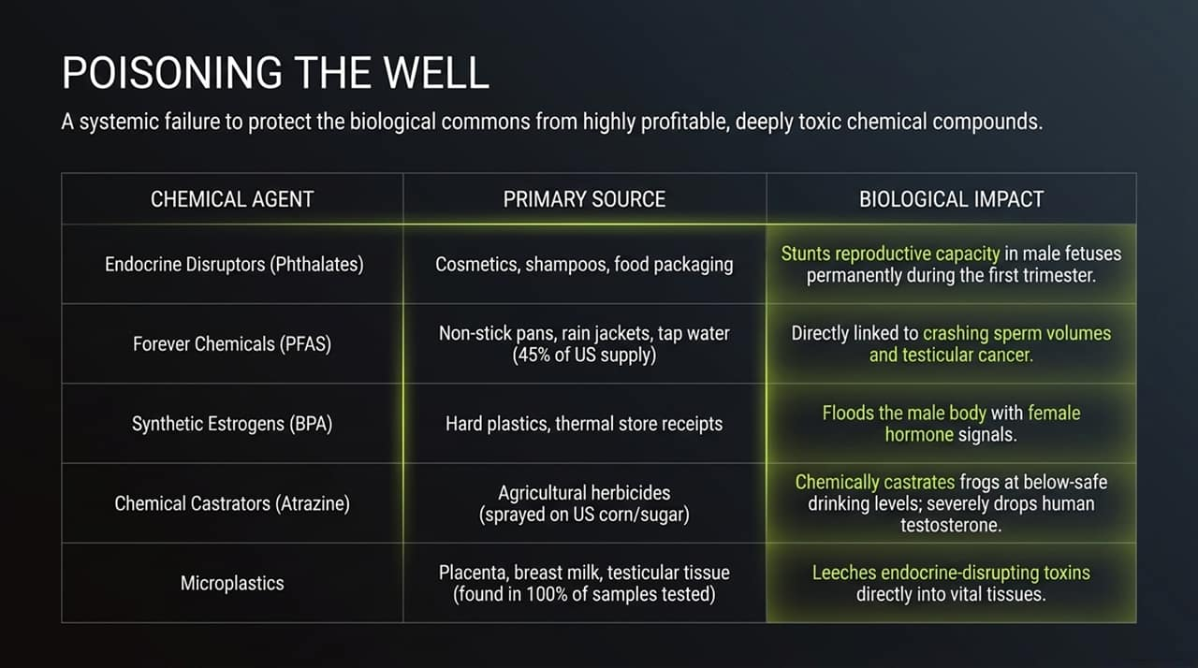
Notes:
Key Objective: Detail the toxic chemical drivers behind the biological collapse.
Why is this biological crash happening? It is the result of a systemic failure to protect the biological commons from profitable, toxic chemical compounds.
Primary Chemical Agents & Impacts:
Phthalates (Endocrine Disruptors): Found in cosmetics, shampoos, and food packaging. Stunts reproductive capacity in male fetuses permanently during the first trimester.
PFAS (Forever Chemicals): Found in non-stick pans, rain jackets, and tap water (present in ~45% of US tap water). Directly linked to crashing sperm volumes and testicular cancer.
BPA (Synthetic Estrogens): Found in hard plastics and thermal store receipts. Floods the male body with female hormone signals.
Atrazine (Chemical Castrators): Herbicide heavily sprayed on US corn and sugar. Shown to chemically castrate amphibians and drastically lower human testosterone.
Microplastics: Found in 100% of tested human placenta, breast milk, and testicular tissue samples.

Slide 8
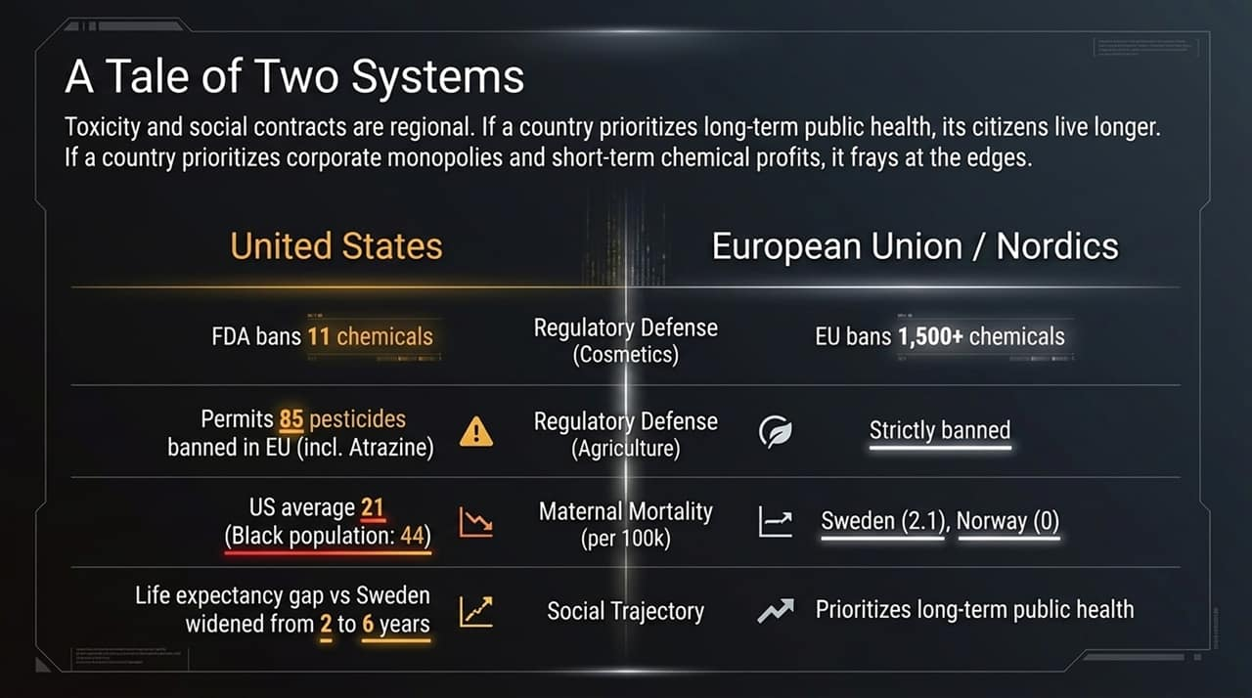
Notes:
Key Objective: Contrast regulatory models (US vs. EU/Nordics) and their impacts on public health.
Biological toxicity and social stability are heavily dictated by regional policy and government regulation.
United States: Prioritizes corporate monopolies and short-term chemical industry profits.
FDA bans only 11–12 chemicals in cosmetics.
Permits 85 pesticides banned in Europe.
Result: Maternal mortality is unusually high (21 per 100k, reaching 44 for Black mothers), and the life expectancy gap versus nations like Sweden has widened from 2 to 6 years.
European Union / Nordics: Applies the precautionary principle to protect public health.
EU bans over 1,500 chemicals in cosmetics.
Strictly bans toxic agricultural herbicides.
Result: Maternal mortality is near zero (e.g., Norway at 0, Sweden at 2.1), and life expectancy continues to climb.

Slide 9
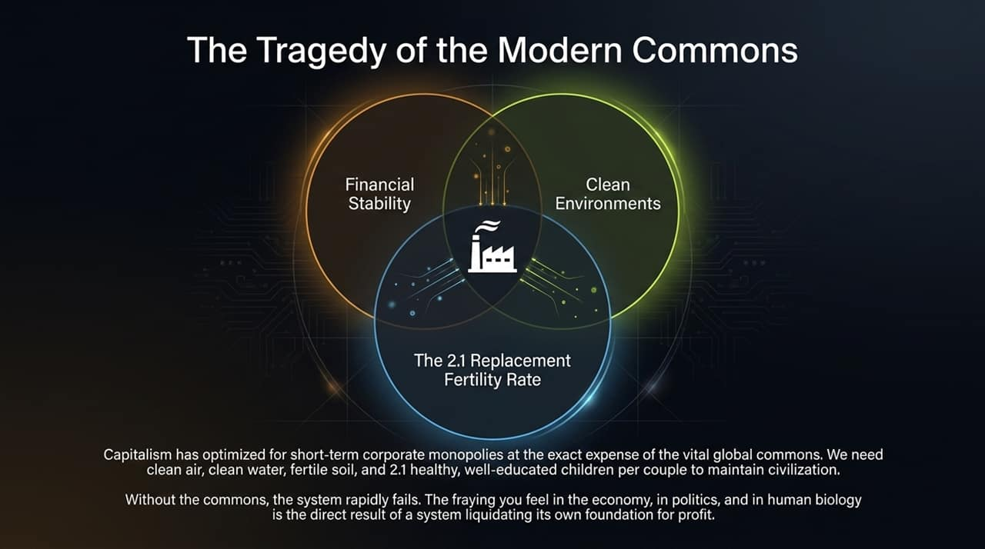
Notes:
Key Objective: Explain the concept of the global commons and why the current economic model is failing.
To maintain a functional civilization, society relies on the Global Commons:
Financial Stability
Clean Environments (air, water, fertile soil)
A 2.1 Replacement Fertility Rate (healthy, well-educated children)
Modern hyper-capitalism has optimized for short-term corporate profits by consuming and liquidating these exact foundations.
The friction we feel today—economic volatility, extreme political polarization, and declining health—is the direct consequence of a system devouring its own base to generate short-term earnings.

Slide 10

Notes:
Key Objective: Provide clear, actionable asset allocation advice based on Grantham’s model.
Institutional Wall Street will not save you. Their business model depends on keeping capital invested in high-fee, hyper-inflated assets. You must manage your capital independently.
Wall Street Consensus vs. The Grantham Defense Portfolio:
US Equities: Exit concentrated US Tech and S&P 500 growth stocks. Pivot 60% into Non-US Equities (Emerging Markets, Japan, Europe) where valuations are significantly lower.
Fixed Income: Allocate 30–35% into cash reserves and government bonds to preserve dry powder.
Alternatives: Allocate 5–10% to Gold and Silver. Avoid Crypto entirely—Grantham views Bitcoin as speculative hype with no intrinsic value.
Strategy: Capital preservation through mean reversion.

Slide 11
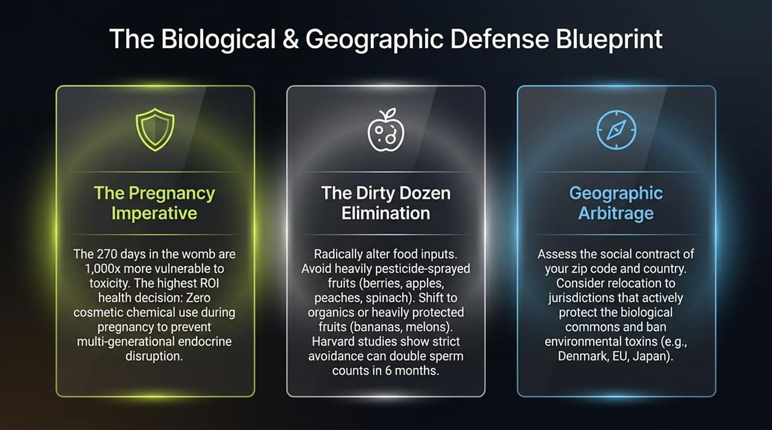
Notes:
Key Objective: Offer personal, health, and location-based mitigation strategies.
Protecting your balance sheet is useless if you don't protect your health and family. Here is the defense blueprint:
1. The Pregnancy Imperative: The 270 days in the womb are 1,000x more vulnerable to toxic chemicals. Eliminating synthetic cosmetics and endocrine disruptors during pregnancy is one of the highest-return health choices you can make.
2. The "Dirty Dozen" Elimination: Avoid produce heavily sprayed with pesticides (strawberries, spinach, apples, peaches). Shift to organics or protected foods (bananas, avocados). Harvard studies show strict avoidance of pesticide-laden foods can significantly improve fertility metrics.
3. Geographic Arbitrage: Evaluate where you live. Consider living in or sourcing products from regions (EU, Japan) that actively regulate environmental toxins and safeguard public health.

Slide 12

Notes:
Key Objective: Address corporate psychology, institutional career risk, and individual action.
Why don't more professionals speak out? Because of institutional inertia. In corporate and financial life, the key political skill is often never to be wrong on your own. If you follow the crowd off a cliff, your career is protected; if you step out of line early, you face reputational risk.
To survive systemic unwinds—financially, biologically, and socially—you must have the courage to inspect raw data, draw independent conclusions, and act before the crowd.
Do not wait for broken institutions to fix these issues. Protect your capital, safeguard your household's health, and build resilient local communities.

Slide 13
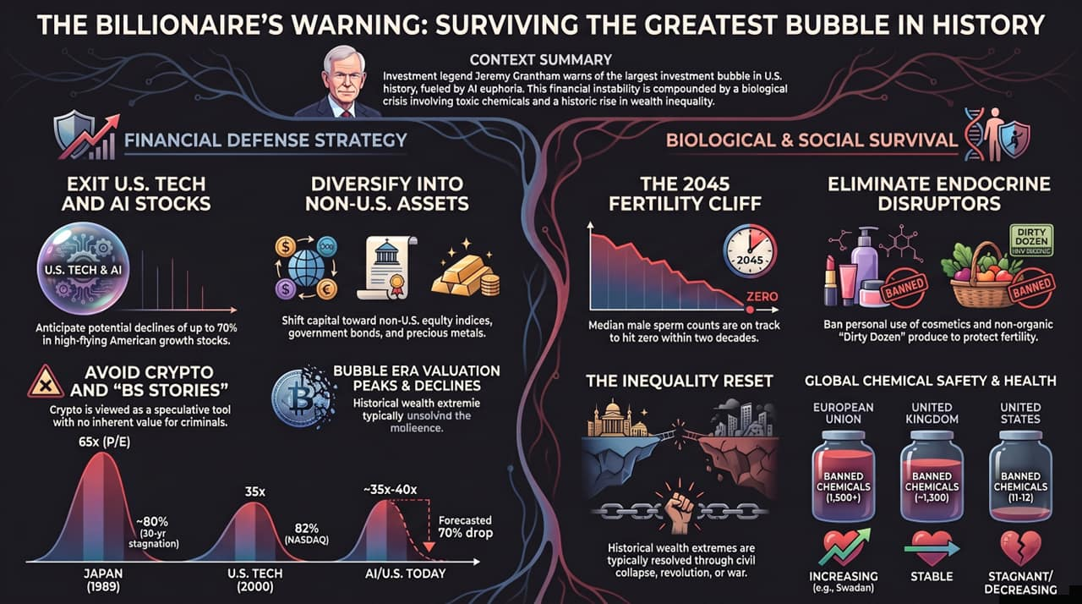
Notes:
Key Objective: Summarize all key takeaways into a final executive action checklist.
This final slide serves as your quick-reference executive dossier:
Financial Defense:
Exit inflated US Tech and AI equities; prepare for potential market drawdowns of up to 70%.
Diversify into value-oriented international equities, government bonds, and precious metals.
Steer clear of crypto and speculative market narratives.
Biological & Personal Survival:
Recognize the demographic reality: male fertility metrics face a steep decline toward 2045.
Audit household inputs: eliminate endocrine disruptors and non-organic "Dirty Dozen" produce.
Understand international regulatory differences (EU vs. US chemical bans) to make safer consumer choices.
Final Thought: Historical wealth and biological imbalances are ultimately self-correcting. Proactive preparation is the best way to safeguard both your wealth and your family's health.

